Slide 1
US Civil Rights Movement
Beginnings through the 60s
By J. Aaron Collins

Slide 2
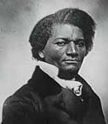
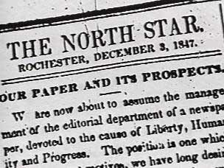
Abolitionists
Frederick Douglas was the editor of an abolitionist newspaper.

Slide 3
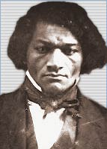
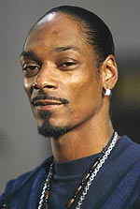
On a side note. . .
Are they related?

Slide 4
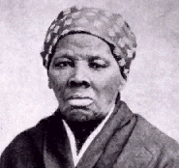
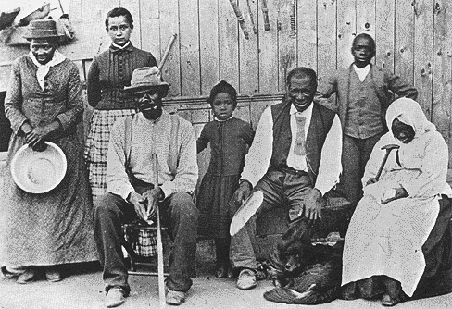
Harriet Tubman
Helped slaves escape via the Underground Railroad.

Slide 5
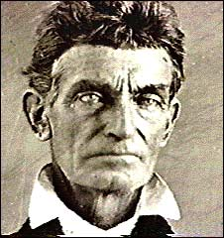
John Brown
He and his sons brutally murdered 5 slave masters in Kansas. (1858)
Tried to incite a slave revolt

Slide 6
Reconstruction 1865-77
After the Civil War 1861-1865, the federal government made strides toward equality.
Blacks voted, held many political offices.
The Freedmen’s Bureau was a govt program to help Blacks find land, it established schools and colleges.

Slide 7
Reconstruction
The Fourteenth Amendment guaranteed all citizens with equal protection under the law.
The Fifteenth Amendment said the right to vote shall not be denied on the basis of race.

Slide 8
However. . .
The Supreme Court decided in Plessy vs. Ferguson that separate institutions are okay if they are equal.
Jim Crow laws required that Blacks have separate facilities.

Slide 9
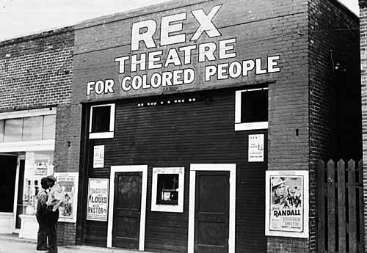

Slide 10
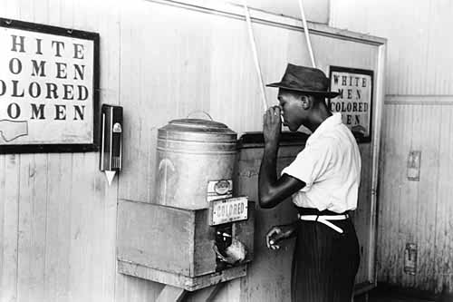

Slide 11
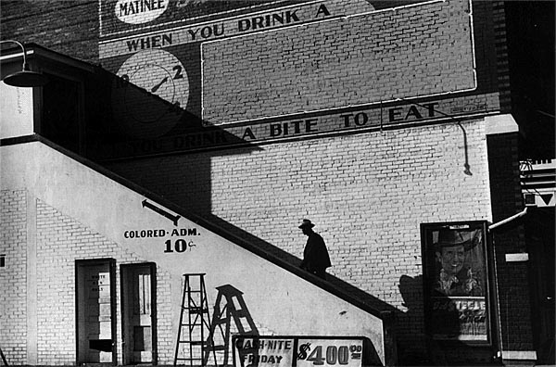

Slide 12
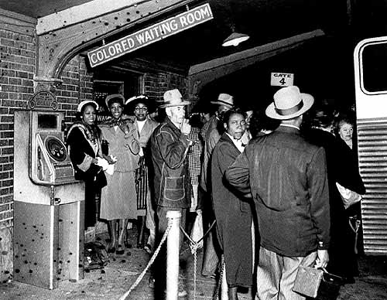
Dallas Bus Station

Slide 13

Jim Crow Laws

Slide 14
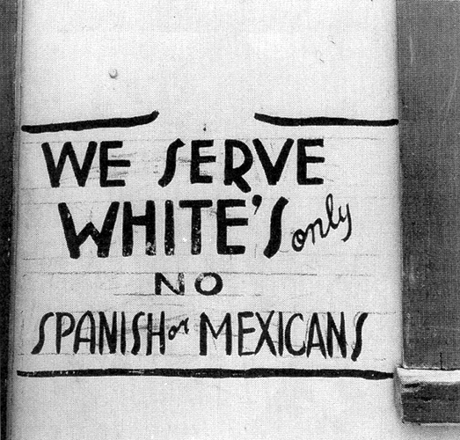
Texas sign

Slide 15
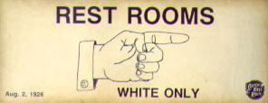
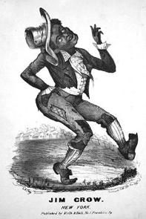
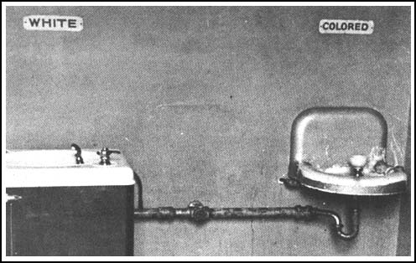
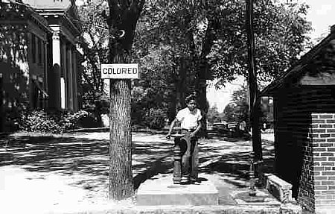

Slide 16

Jim Crow Laws

Slide 17
Jim Crow Laws

Slide 18

Jim Crow Laws

Slide 19
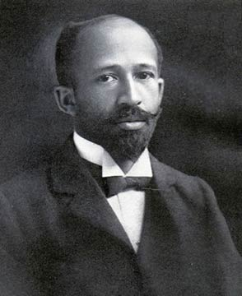
NAACP
Founded in 1909 by W.E.B. Dubois
Fought for equality

Slide 20
NAACP fought in the courts
Thurgood Marshall was hired by the NAACP to argue in the Supreme Court against school segregation. He won.
He was later the 1st Black Supreme Court Justice.

Slide 21
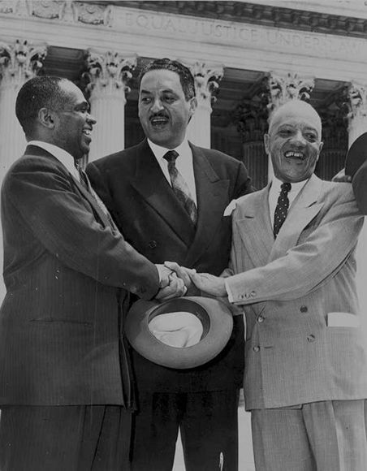
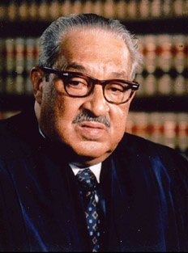
Thurgood Marshall

Slide 22
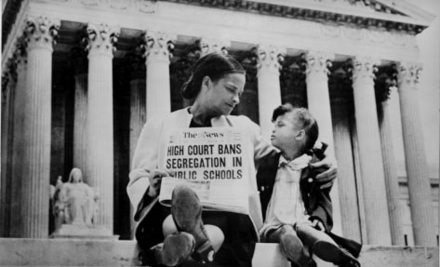
Brown vs. Board of Education 1954

Slide 23
The Fight
Many African Americans and whites risked their lives and lost their lives to remedy this situation.
Rosa Parks was not the first, but she was the beginning of something special.

Slide 24
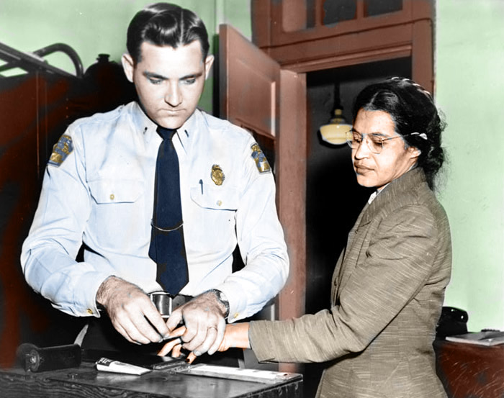
Montgomery Bus Boycott, 1955
Rosa Parks was arrested for violating the segregation laws of Montgomery, Alabama.

Slide 25
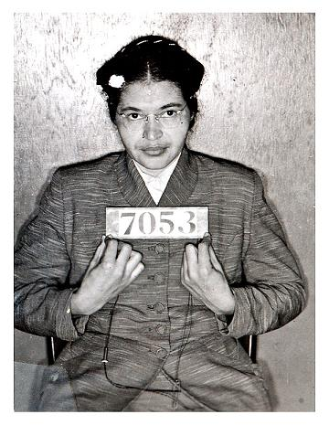

Slide 26
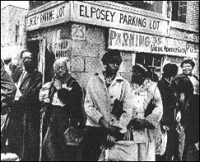
In Response. . .
For over a year, Blacks boycotted the buses.
They carpooled and walked through all weather conditions

Slide 27
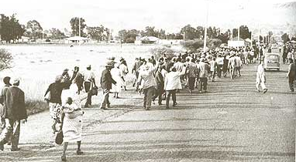
Many were arrested for an “illegal boycott” including their leader. . .

Slide 28
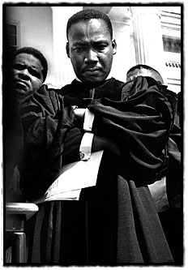

Slide 29
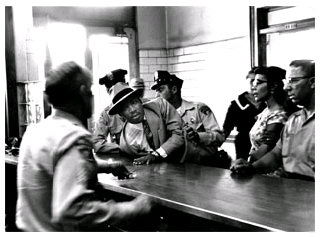
Martin Luther King Jr.

Slide 30
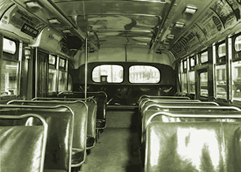
http://www.africanaonline.com/Graphic/rosa_parks_bus.gif
While the NAACP fought in the courts, MLK’s organization led the boycott.

Slide 31
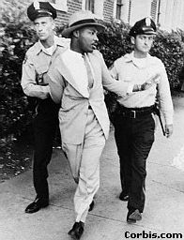
King’s sacrifice
King was arrested thirty times in his 38 year life.
His house was bombed or nearly bombed several times
Death threats constantly

Slide 32
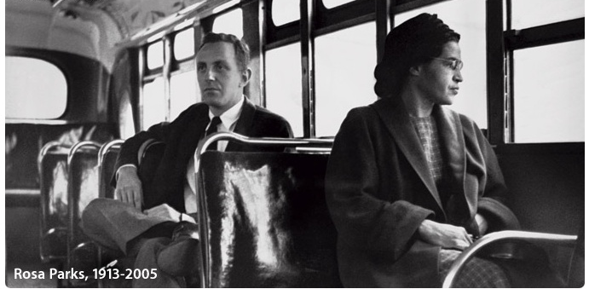
Success!

Slide 33
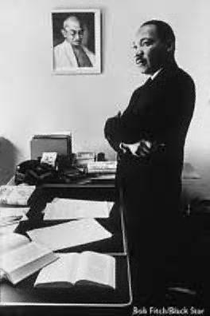
Gandhi inspired King to be direct and nonviolent towards Whites.

Slide 34
Violence never solves problems. It only creates new and more complicated ones. If we succumb to the temptation of using violence in our struggle for justice, unborn generations will be the recipients of a long and desolate night of bitterness, and our chief legacy to the future will be an endless reign of meaningless chaos.
--Dr. Martin Luther King, Jr., "Facing the Challenge of a New Age"

Slide 35
Get ready for your quiz!
6 questions

Slide 36
Quiz
1. Name 2 abolitionists from the 1800s.
2. Whose arrest sparked the Montgomery Bus Boycott?
3. Who founded the NAACP in 1909?

Slide 37
4. Who inspired MLK’s nonviolent strategies?
5. Which laws required segregation?
6. Which Supreme Court case integrated schools?

Slide 38
What to do next?
You can’t boycott something that doesn’t want your business anyway!
A new, nonviolent tactic was needed.

Slide 39
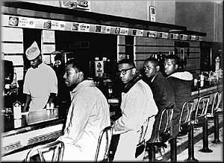
Sit ins
This was in Greensboro, North Carolina

Slide 40
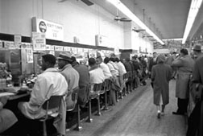
They were led not by MLK but by college students!

Slide 41
Sit-in Tactics
Dress in you Sunday best.
Be respectful to employees and police.
Do not resist arrest!
Do not fight back!
Remember, journalists are everywhere!

Slide 42
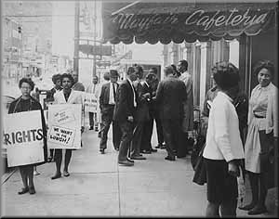

Slide 43
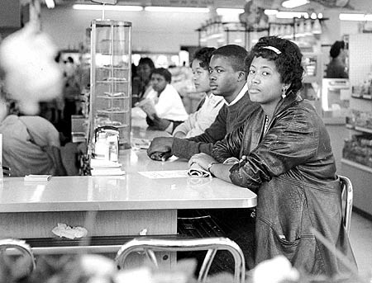
Students were ready to take your place if you had a class to attend.

Slide 44
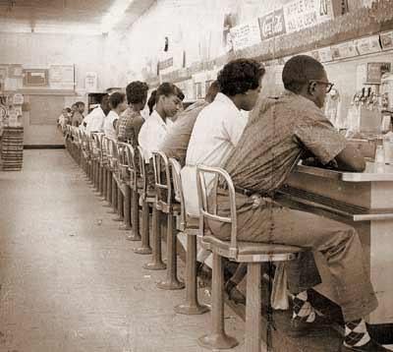

Slide 45
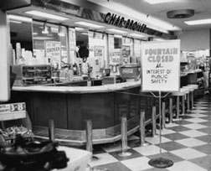

Slide 46
Not only were there sit-ins. .
Swim ins (beaches, pools)
Kneel ins (churches)
Drive ins (at motels)
Study-ins (universities)

Slide 47
March on Washington 1963
President Kennedy was pushing for a civil rights bill.
To show support, 500,000 African Americans went to Washington D.C.

Slide 48
School Integration
The attitude of many schools after the 1954 Brown decision was like:
Come Make Me!

Slide 49
Federalism
When Federal troops are sent to make states follow federal laws, this struggle for power is called federalism.
The Civil Rights Movement was mostly getting the federal government to make state governments to follow federal law.

Slide 50
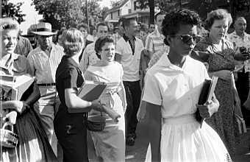
Little Rock, Arkansas 1957

Slide 51
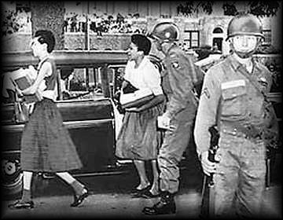
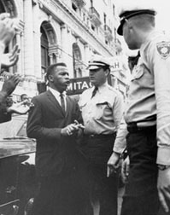
States were not following federal law. Feds were sent in.

Slide 52
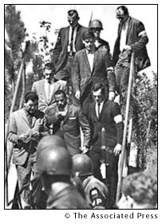
James Meredith, University of Mississippi, escorted to class by U.S. marshals and troops. Oct. 2, 1962.

Slide 53
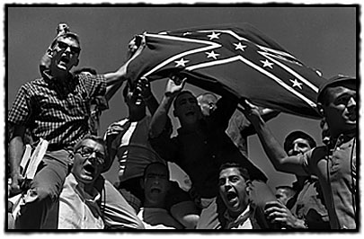
Ole Miss fought against integration

Slide 54
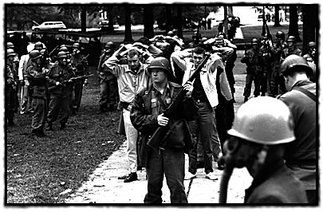
200 were arrested during riots at Ole Miss

Slide 55
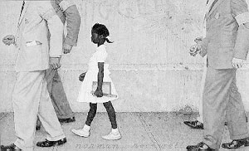
States ignored the ’54 Brown decision, so Feds were sent in.

Slide 56
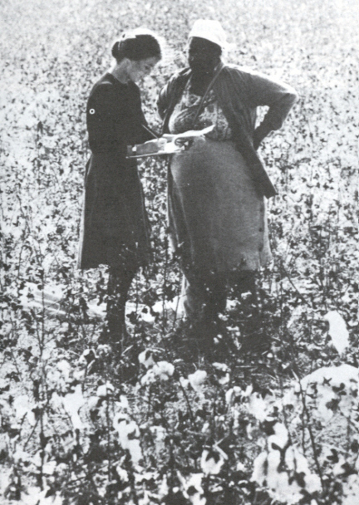
Voter Registration
CORE volunteers came to Mississippi to register Blacks to vote.

Slide 57
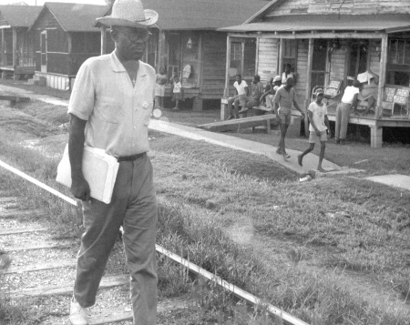
These volunteers risked arrest, violence and death
every day.

Slide 58
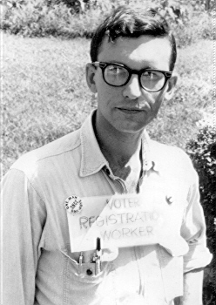
The Fight
This man spent 5 days in jail for “carrying a placard.”
Sign says “Voter registration worker”

Slide 59
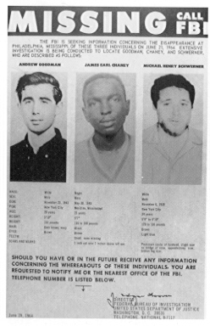
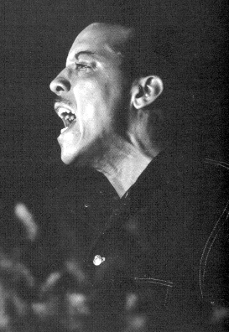
"Your work is just beginning. If you go back home and sit down and take what these white men in Mississippi are doing to us. ...if you take it and don't do something about it. ...then *%# damn your souls."

Slide 60
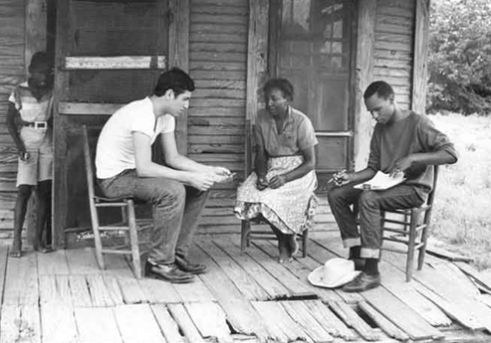
Voter Registration
If Blacks registered to vote, the local banks could call the loan on their farm.

Slide 61
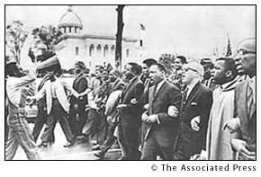
Thousands marched to the Courthouse in Montgomery to protest rough treatment given voting rights demonstrators. The Alabama Capitol is in the background. March 18,1965

Slide 62


High Schoolers jailed for marching
Oh Wallace,
you never can jail us all,
Oh Wallace,
segregation's bound to fall

Slide 63

Bloody Sunday
In Selma, pro-vote marchers face Alabama cops.

Slide 64


Slide 65


Selma to Montgomery, Alabama

Slide 66


Tending the wounded

Slide 67

Marchers cross bridge

Slide 68

Many were arrested.

Slide 69

Police set up a rope barricade.

Slide 70

Marchers stayed there for days.

Slide 71

We're gonna stand here 'till it falls,
‘Till it falls,
‘Till it falls,
We're gonna stand here 'till it falls
In Selma, Alabama.

Slide 72

The Supreme Court ruled that protesters had 1st Amendment right to march.

Slide 73

Sacrifice for Suffrage

Slide 74

Crime Scene
This woman was killed by the KKK while on her way to join voter activists in Mississippi

Slide 75

Selma to Montgomery Part 2

Slide 76

Part 2

Slide 77
Why march and risk personal injury?

Slide 78

Headlines!
People around world will convert to your cause if they see you on TV or on the front page of the newspaper.

Slide 79

Birmingham, Alabama 1963

Slide 80






Slide 81

Police use dogs to quell civil unrest in Birmingham, Ala. in May of 1963. Birmingham's police commissioner "Bull" Connor also allowed fire hoses to be turned on young civil rights demonstrators.

Slide 82

Birmingham

Slide 83


Slide 84


Slide 85
Birmingham
White America saw 500 kids get arrested and attacked with dogs.
There was much support now for civil rights legislation.

Slide 86

March on Washington 1963

Slide 87

The event was highlighted by King's "I Have a Dream" speech in front of the Lincoln Memorial. August 28, 1963.

Slide 88
Civil Rights Act of 1964
Banned segregation in public places such as restaurants, buses

Slide 89

Lyndon B. Johnson ’63-’68
Pushed Civil Rights Act through Congress
Passed more pro-civil rights laws than any other president

Slide 90

Lyndon Baines Johnson (LBJ)
Civil Rights Act of ’64
Civil Rights Act of ’68
Voting Rights Act of ’65
24th Amendment banning poll taxes

Slide 91
Freedom Riders
Now it is time to test the small-town bus stops and highways!

Slide 92
Freedom Riders
CORE volunteers, White and Black, got on buses and sat inter-racially on the bus.
They went into bus station lunch counters

Slide 93

Freedom Riders attacked!

Slide 94

Mobs also attacked them at the bus stations.

Slide 95
Highways
The highways were obviously not safe.

Slide 96

James Meredith, right, pulled himself to cover against a parked car after he was shot by a sniper. Meredith had been leading a march to encourage African Americans to vote. He recovered from the wound, and later completed the march. June 7, 1966

Slide 97

Malcolm X and MLK

Slide 98

Left to right: Hosea Williams, Jesse Jackson, Martin Luther King Jr., Rev. Ralph David Abernathy on the balcony of the Lorraine Motel Memphis hotel, a day before King's assassination.
April 3,1968

Slide 99

Aides of the Rev. Dr. Martin Luther King point out to police the path of the assassin's bullet. Joseph Louw, photographer for the Public Broadcast Laboratory, rushed from his nearby motel room in Memphis to record the scene moments after the shot. Life magazine, which obtained exclusive rights to the photograph, made it public. April 4, 1968.

Slide 100

Civil Rights legal achievements
Harry Truman ordered the armed forces AND the government to be desegregated.

Slide 101

Dwight D. Eisenhower
Sent 101st airborne to Little Rock, Arkansas to maintain order.

Slide 102

John F. Kennedy
Called Coretta Scott King to pledge support while MLK was in jail.
Eventually sent federal protection of freedom riders
Proposed need for civil rights legislation

Slide 103
This powerpoint was kindly donated to www.worldofteaching.com
http://www.worldofteaching.com is home to over a thousand powerpoints submitted by teachers. This is a completely free site and requires no registration. Please visit and I hope it will help in your teaching.

